Slide 1
Evaluation of Vector-Matrix Multiplier using optical devices
Koji Sato
Kyushu-University

Slide 2
Agenda
Background
Purpose
Introduction of optical VMM
Evaluation
Area
latency
Plan
Summary

Slide 3
Agenda
Background
Purpose
Introduction of optical VMM
Evaluation
Area
latency
Plan
Summary

Slide 4
Background
Need for processing more data with low latency, and low power consumption
Cyber physical system
Physical limitation of CMOS device
Ohmic loss
Leakage current

Slide 5
Optical device
Advantage of optical device
Low latency
Improvement of optical device
Miniaturization
Low power consumption
Large scale integrated
Compute with optical device!

Slide 6
Problem
Vector-Matrix Multiplier(VMM)
Vector-Matrix operation is used in many applications
e.g.) neural network, image processing
VMM can be realized with optical device
No comparison with optical device and CMOS

Slide 7
Purpose
Purpose of my work
Evaluation of VMM consisting of optical devices
Latency
Area
Power consumption
Accuracy
Contrasting optical VMM with other VMMs
ASIC(Application Specific Integrated circuit)
GPU

Slide 8
Agenda
Background
Purpose
Introduction of optical VMM
Evaluation
Area
latency
Plan
Summary

Slide 9
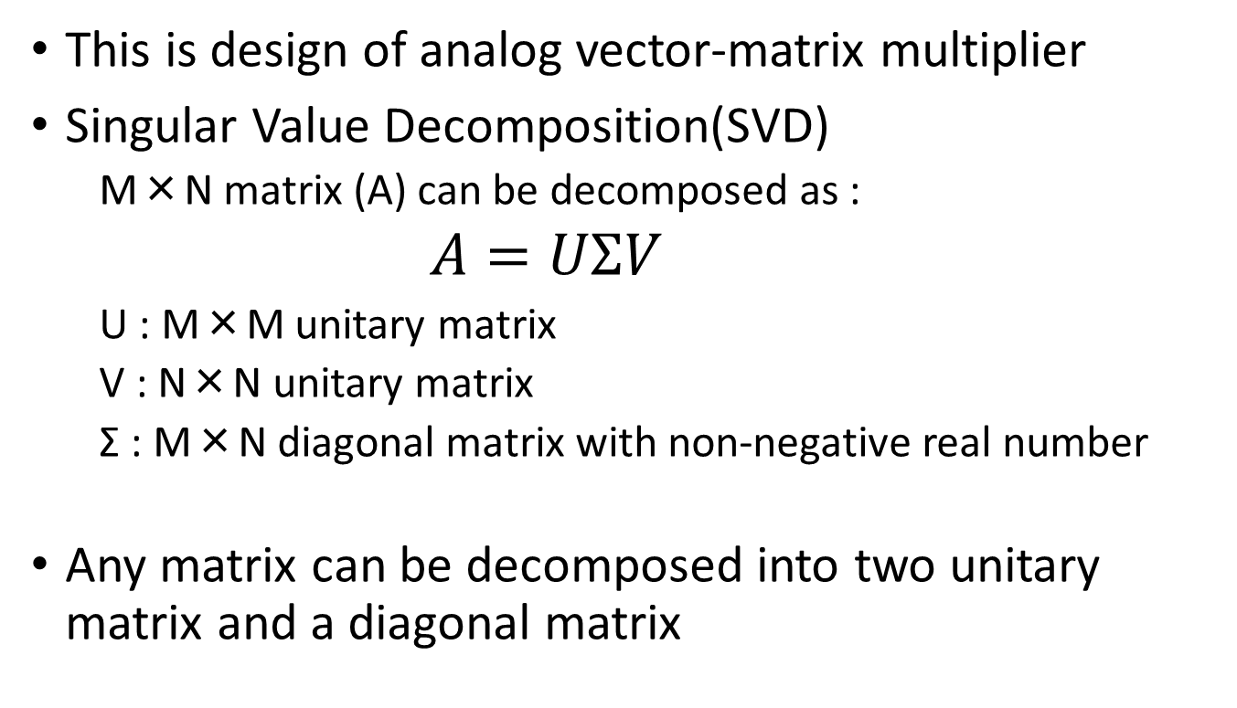
Introduction of optical VMM
This is design of analog vector-matrix multiplier
Singular Value Decomposition(SVD)
M×N matrix (A) can be decomposed as :
$A=UΣV$
U : M×M unitary matrix
V : N×N unitary matrix
Σ : M×N diagonal matrix with non-negative real number
Any matrix can be decomposed into two unitary matrix and a diagonal matrix

Slide 10


Introduction of optical VMM
Diagonal matrix Σ can be implemented with amplifier
$σ_{1},σ_{2},…,σ_{r}$are amplifiers (r : rank of A)
Unitary matrix U and V can be implemented with Mach-Zender interferometer(MZI) and phase shifter
Input
Output
Matrix A

Slide 11
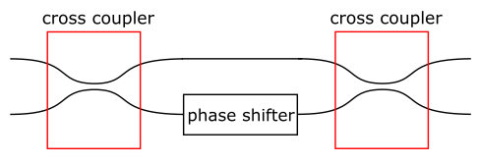
Introduction of MZI
MZI(Mach-Zenhder Interferometer)
Input side
Output side
Control signal
Cross coupler : coupling two of input lightwave
Phase shifter : shift lightwave’s phase depending on control signal

Slide 12
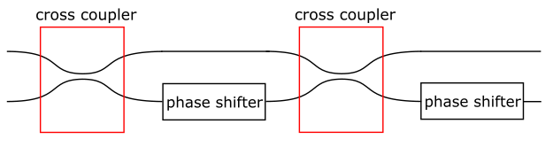
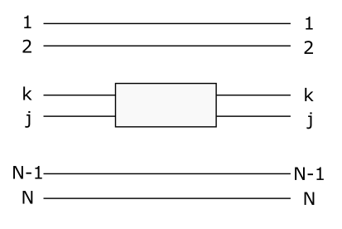
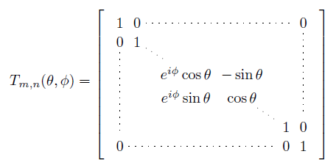



Introduction of MZI VMM
MZI unitary matrix transformation
This component corresponds to
a following matrix transformation:
$$T(θ,φ)=\left(\begin{matrix}e^{iφ}sinθ & e^{iφ}cosθ \\ cosθ & −sinθ\end{matrix}\right)$$
2θ
Φ
Row
k
j
・・・
・・・
・・・
$$k,j$$
・・・
・・・
・・・
Column k j

Slide 13
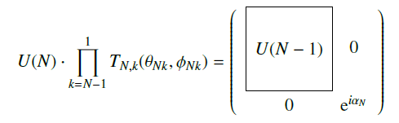
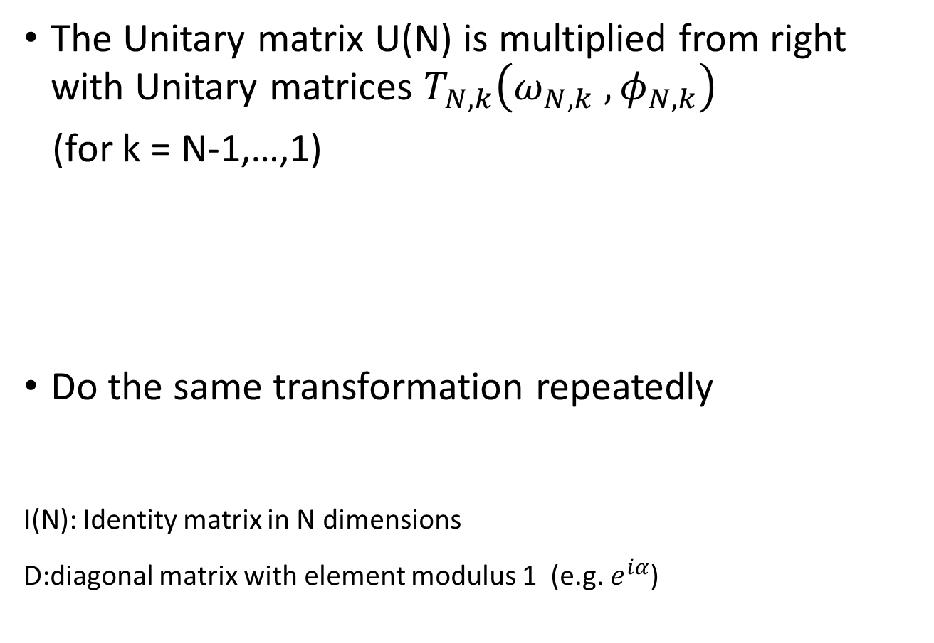
Introduction of MZI VMM
The Unitary matrix U(N) is multiplied from right with Unitary matrices $T_{N,k}\left(ω_{N,k} ,φ_{N,k}\right)$
(for k = N-1,…,1)
Do the same transformation repeatedly
I(N): Identity matrix in N dimensions
D:diagonal matrix with element modulus 1 (e.g. $e^{iα}$)

Slide 14

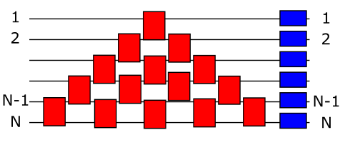
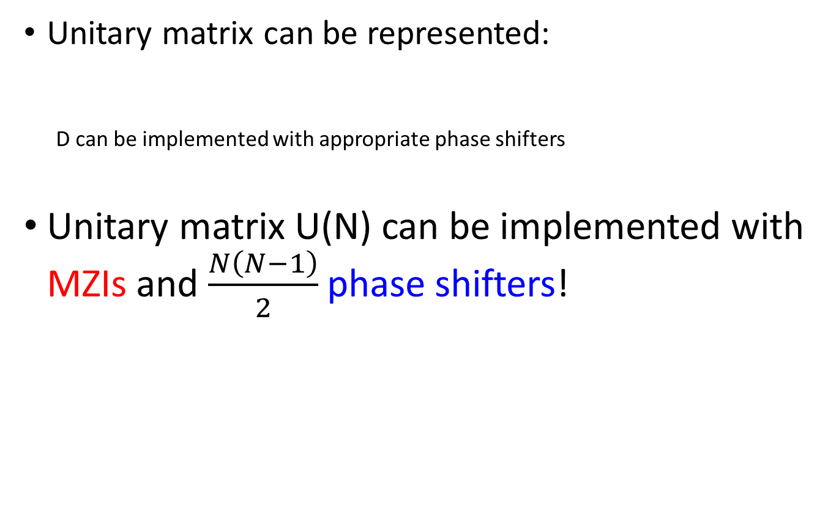
Introduction of MZI VMM
Unitary matrix can be represented:
D can be implemented with appropriate phase shifters
Unitary matrix U(N) can be implemented with MZIs and $\frac{N\left(N−1\right)}{2}$phase shifters!
…
…
Input
Output

Slide 15
Introduction of MZI VMM
Input
Light sources generate optical signals
Output
Photo detector detect optical power
Light source
Photo detector

Slide 16
Agenda
Background
Purpose
Introduction of optical VMM
Evaluation
Latency
Area
Plan
Summary

Slide 17
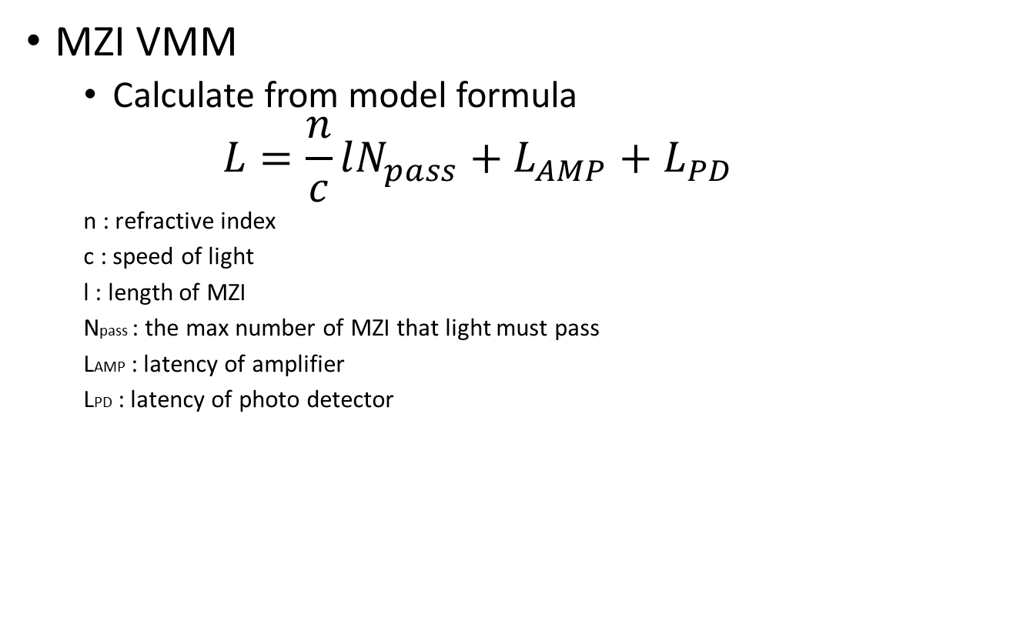
Latency :Method of evaluation
MZI VMM
Calculate from model formula
$$L=\frac{n}{c}lN_{pass}+L_{AMP}+L_{PD}$$
n : refractive index
c : speed of light
l : length of MZI
Npass : the max number of MZI that light must pass
LAMP : latency of amplifier
LPD : latency of photo detector

Slide 18
Latency :Method of Evaluation
GPU
Use library CUBLAS(CUDA Basic Linear Algebra subprograms)
Run on NVIDEA Tesla k20m (354nodes)
345.6GFLOPS
Memory 128GB
Bandwidth 102.4GB
compute 400times on each matrix size and get the average latency

Slide 19
Evaluation : latency of VMM
MZI VMM can compute much faster than other VMMs

Slide 20

Area : Method of evaluation
MZI VMM
Calculate from model formula (assuming M=N)
$$S={S_{S}×N+S}_{MZI}×N\left(N−1\right)+$$
$S_{AMP}×N+S_{PD}×N$
SS :size of a light source
SMZI : size of a MZI
SAMP : size of amplifier
SPD : size of photo detector
N: size of matrix
Light source
Photo detector

Slide 21
Area : Evaluation
I will contrast area of MZI VMM with ASIC VMM

Slide 22
Agenda
Background
Purpose
Introduction of optical VMM
Evaluation
Area
latency
Plan
Summary

Slide 23
Plan
Evaluate accuracy of MZI VMM
Survey about noise of optical devices
Optical amplifier
Phase shifter
Photo detector
Evaluate performance of other VMM
ASIC

Slide 24
Agenda
Background
Purpose
Introduction of optical VMM
Evaluation
Area
latency
Plan
Summary

Slide 25
Summary
Introduce MZI VMM
My work is to compare vector-matrix multiplications
MZI VMM
GPU
ASIC
Plan to evaluate MZI VMM’s accuracy

